Slide 1
Image
Processing
Accelerator
Team 36
311551007 江智端
311551144 王昇暉
311553046 楊宗泰
2022/12/29

Slide 2
Outline
01. Project Motivation
04. Assumption
02. Background Introduction
05. Experiment Result
03. Method
06. Conclusion

Slide 3

Motivation

Slide 4
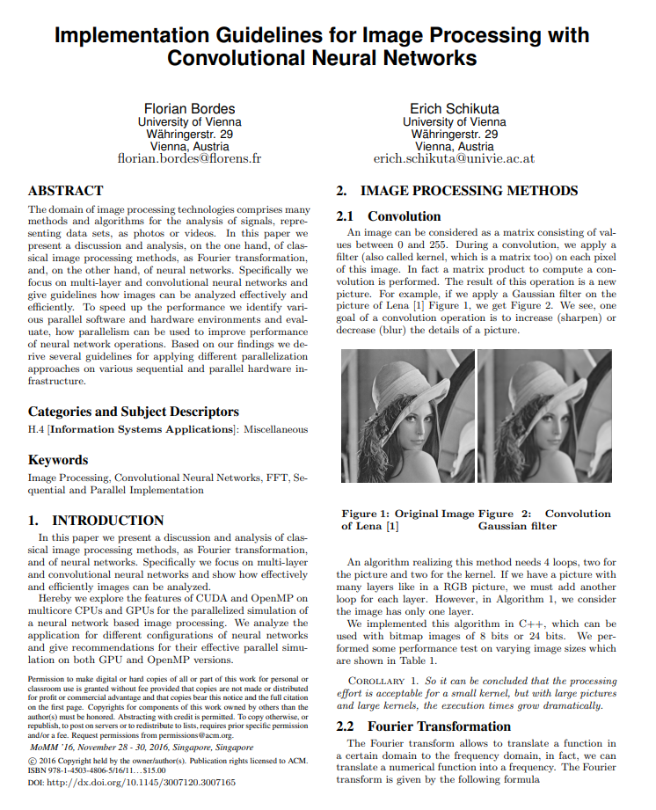
Motivation
The main problem is that image processing is generally a time-consuming process.
The validation machine is bulky and unportable, it also takes a lot of time due to its old system and serial programming.
Parallel Computing provides an efficient and convenient way to address this issue.
Our main purpose of this research is to analyze different parallel programming ways such as SIMD, CUDA, OpenCL, OpenMP …etc.

Slide 5
Background Introduction

Slide 6




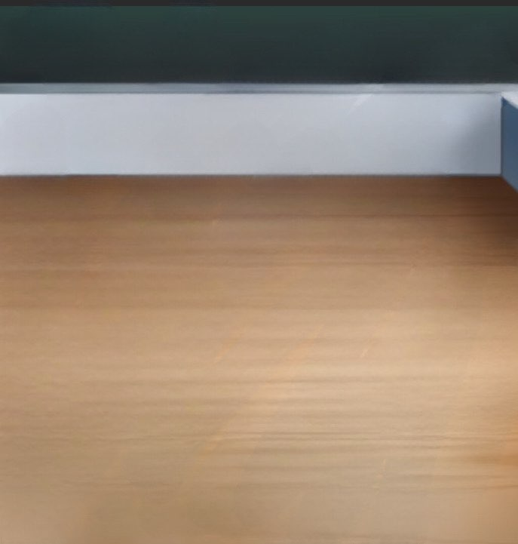
Add & Sub

Slide 7

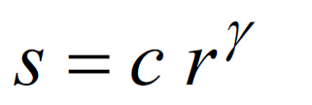


Gamma Correction
C=1, r is original pixel value
Gamma = 2
Gamma = 0.5
Normalization

Slide 9
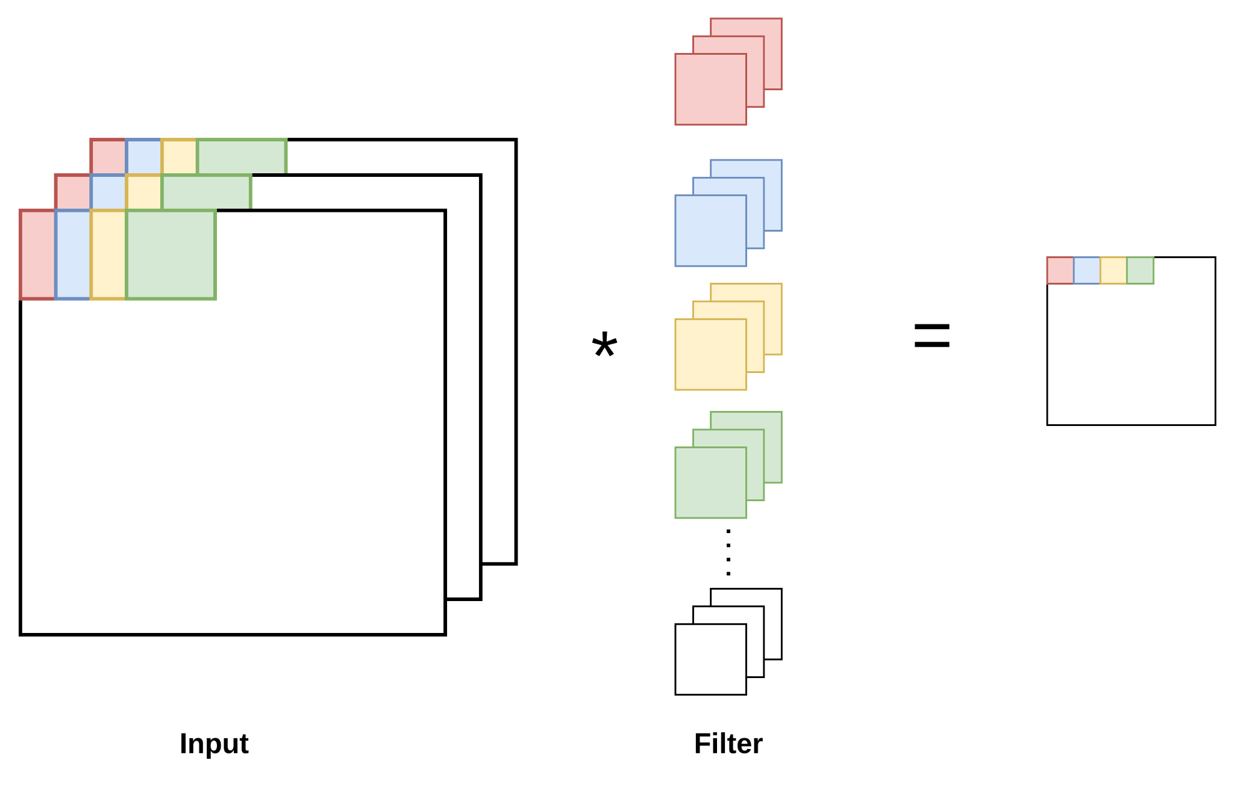
Convolution
Output

Slide 10
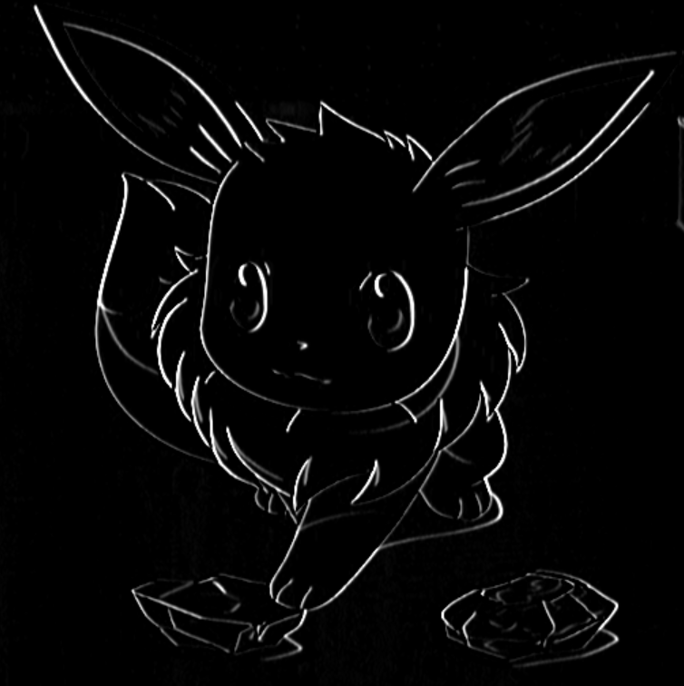
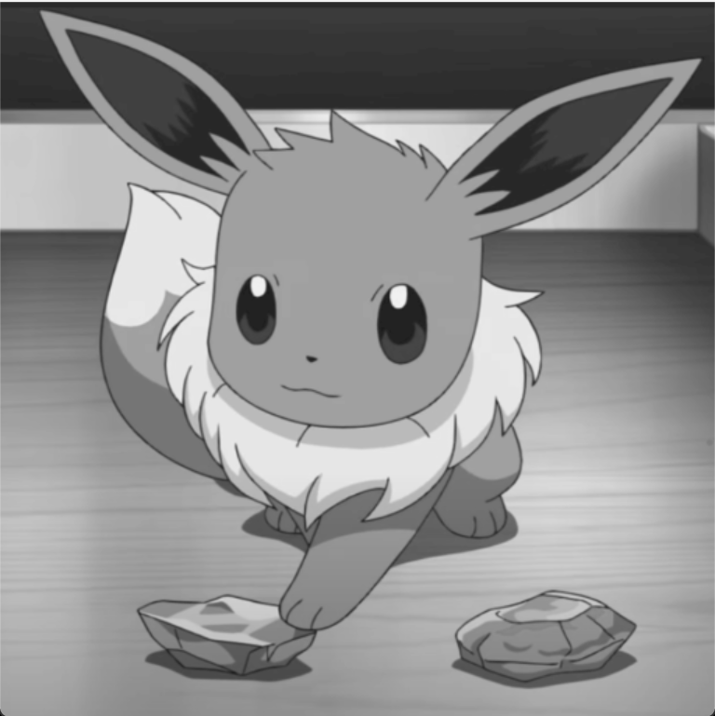
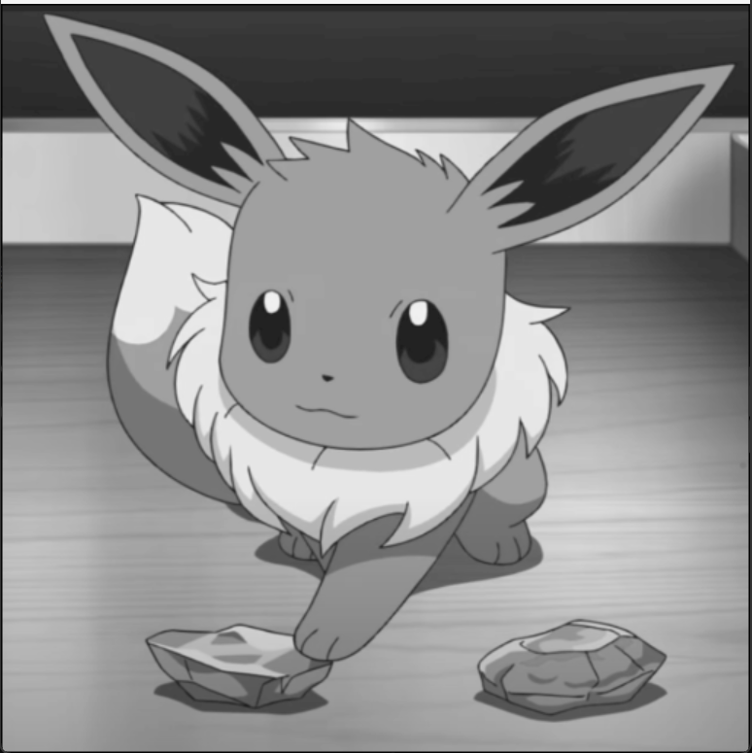
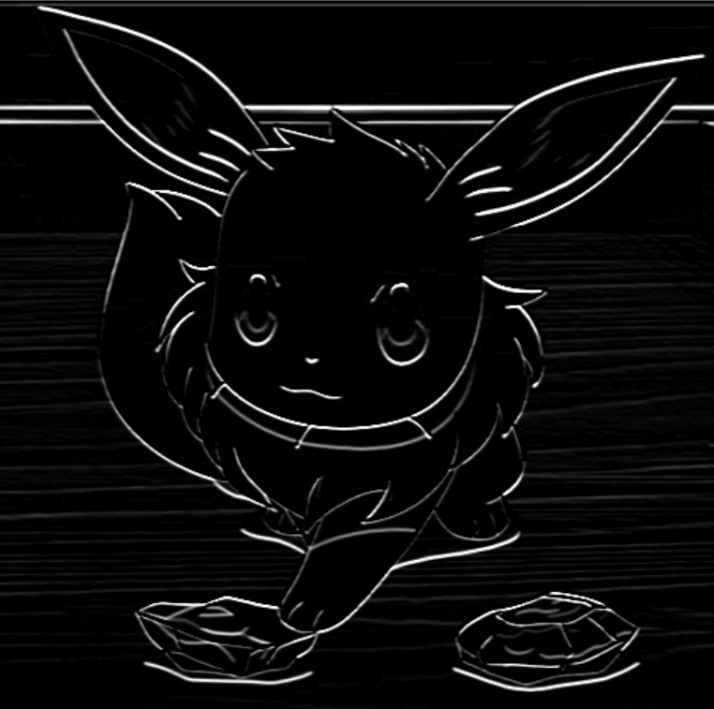
Convolution
Vertia
padding
Horizont

Slide 11
Method

Slide 12
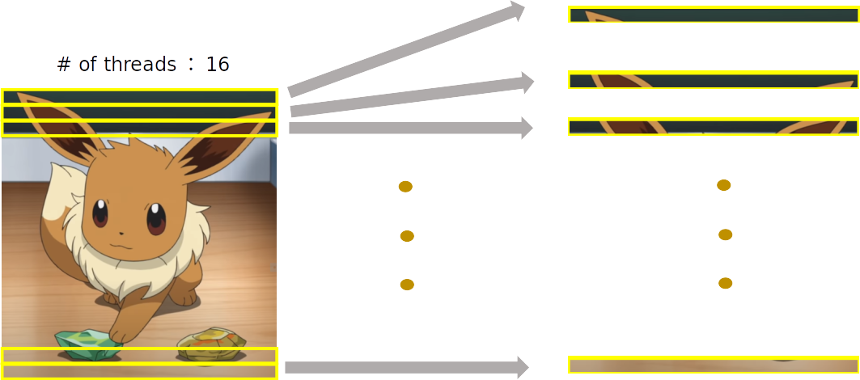
Pthreads
Separate the image into 16(threads number) parts by its height

Slide 13
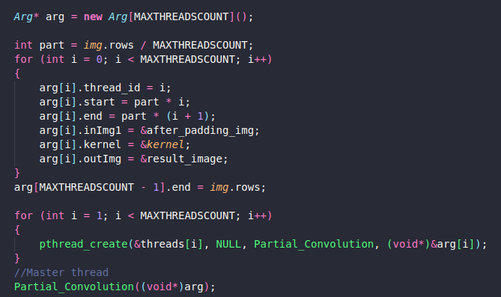
Pthread

Slide 14
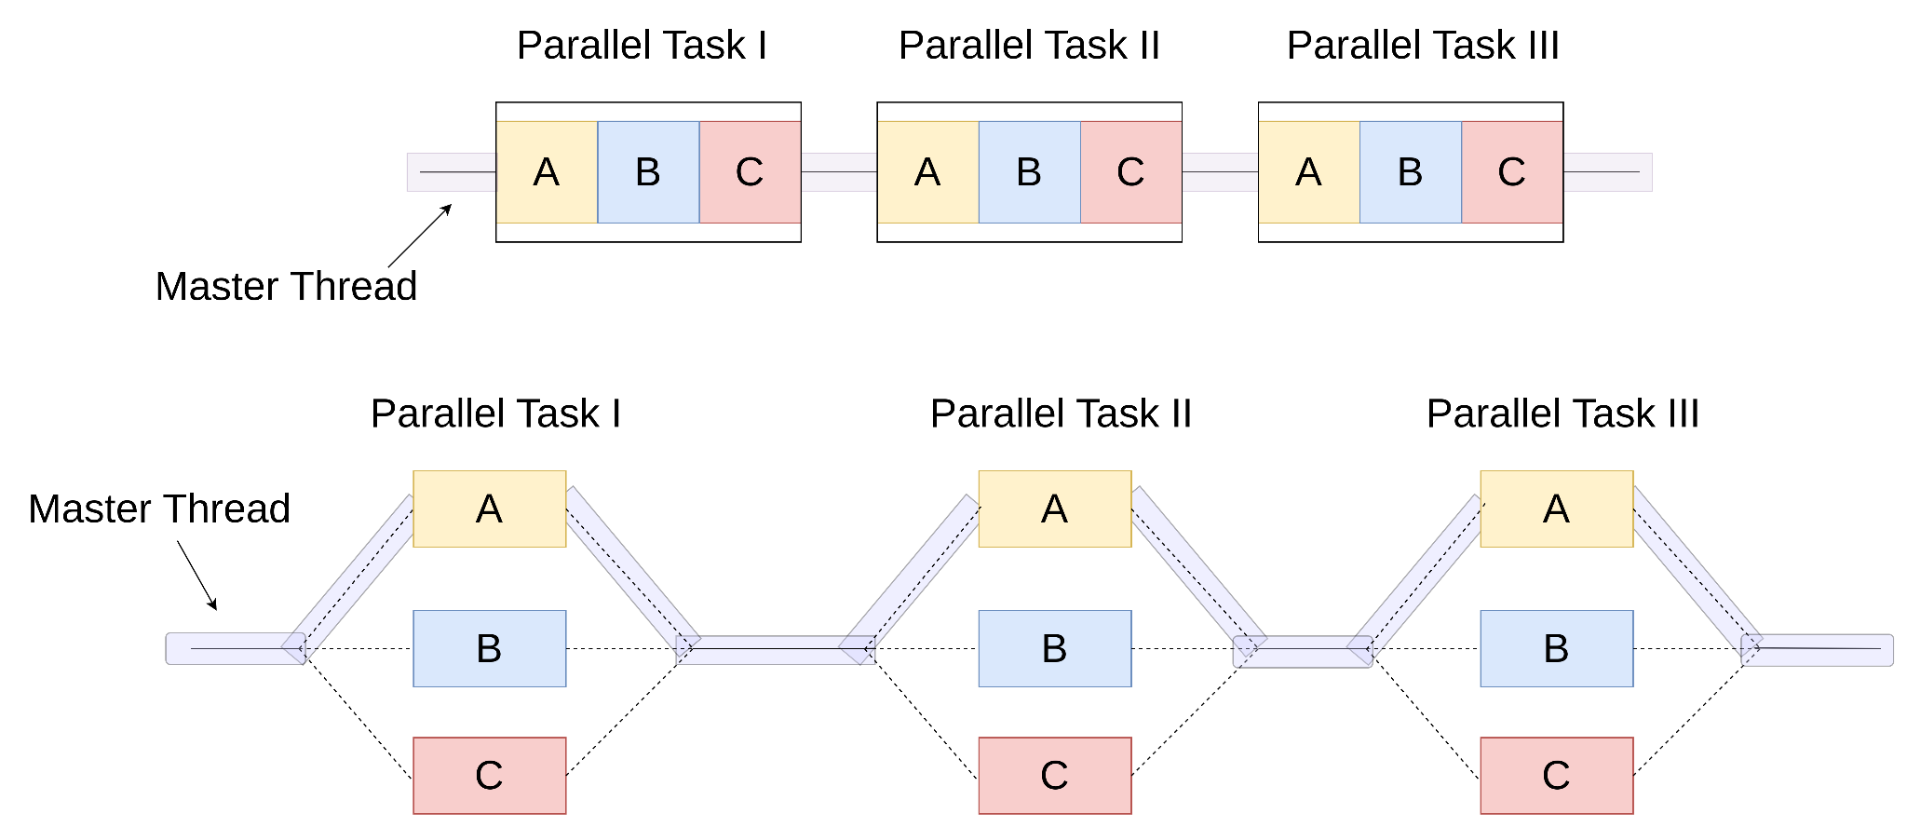
OpenMp
Let the sum is shared, every partial sum will parallel calculate,
and the final main thread will collect all the answers.

Slide 15
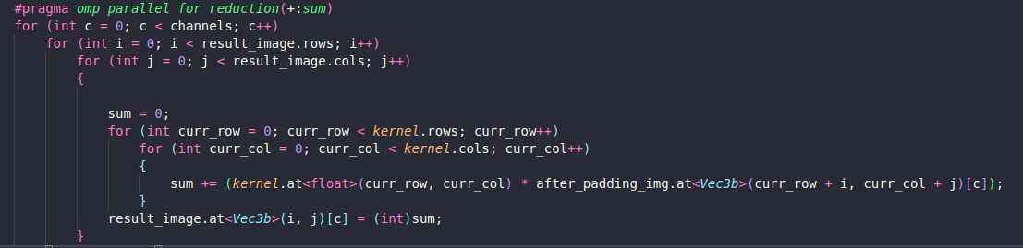
OpenMp

Slide 16
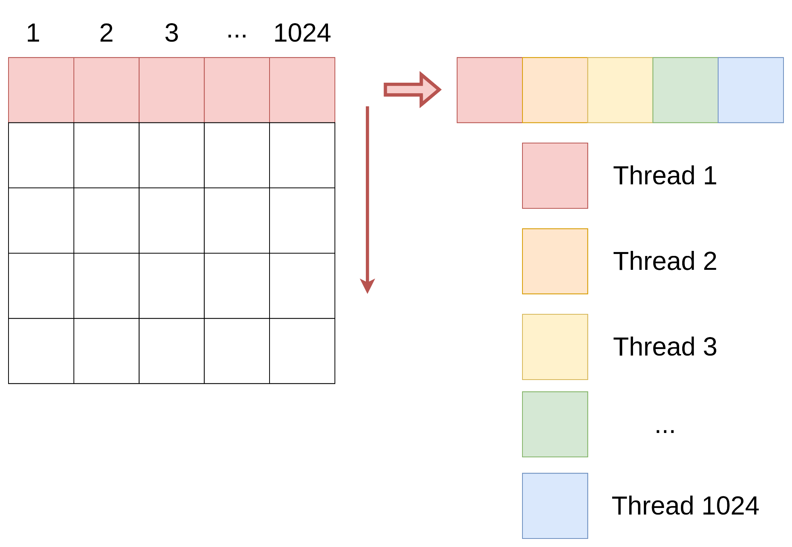
CUDA

Slide 17
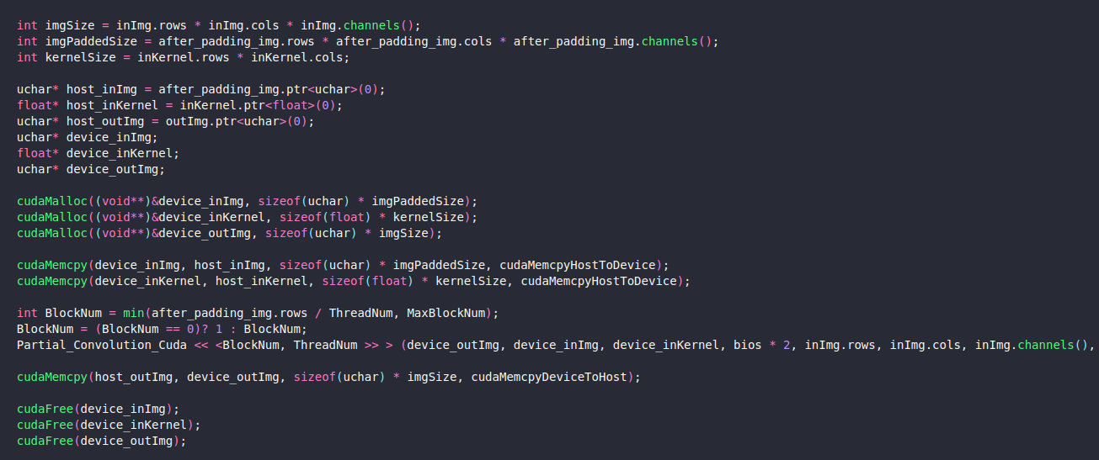
CUDA

Slide 18
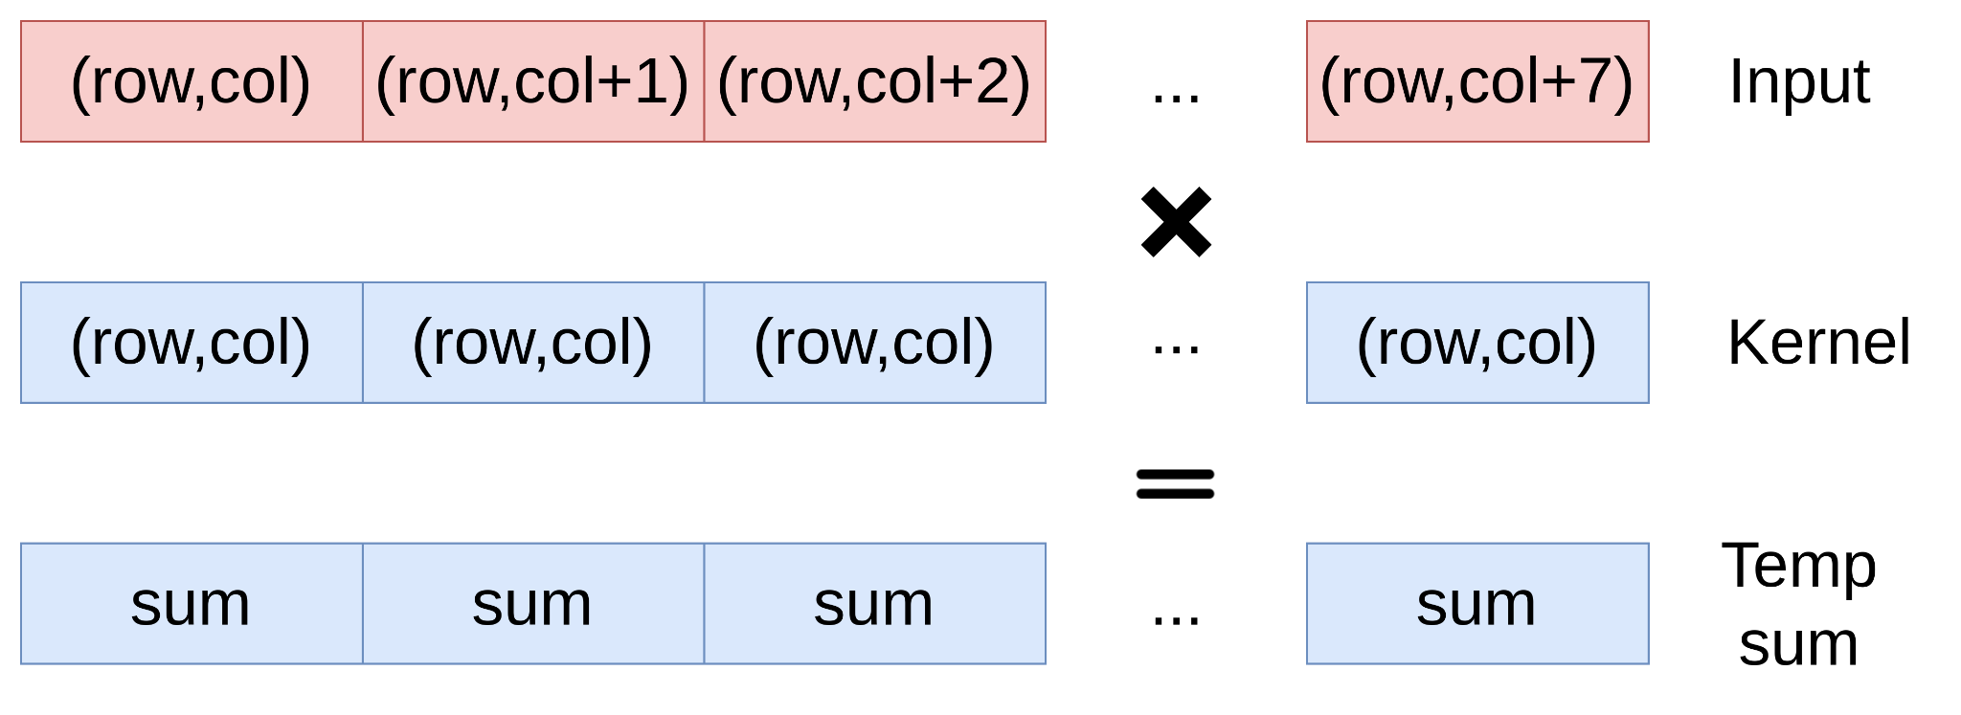
SIMD
Store 8 elements into a vector, and calculate the 8 output pixels once again.

Slide 19
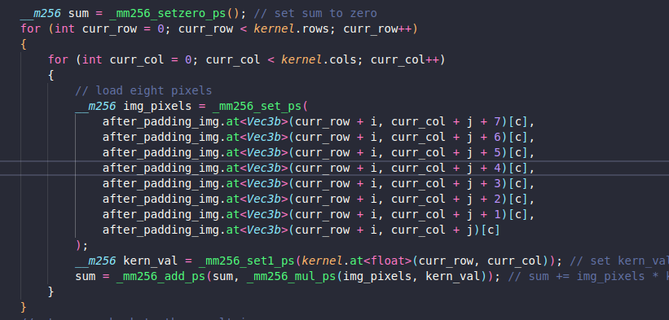
SIMD

Slide 20
Assumption

Slide 21
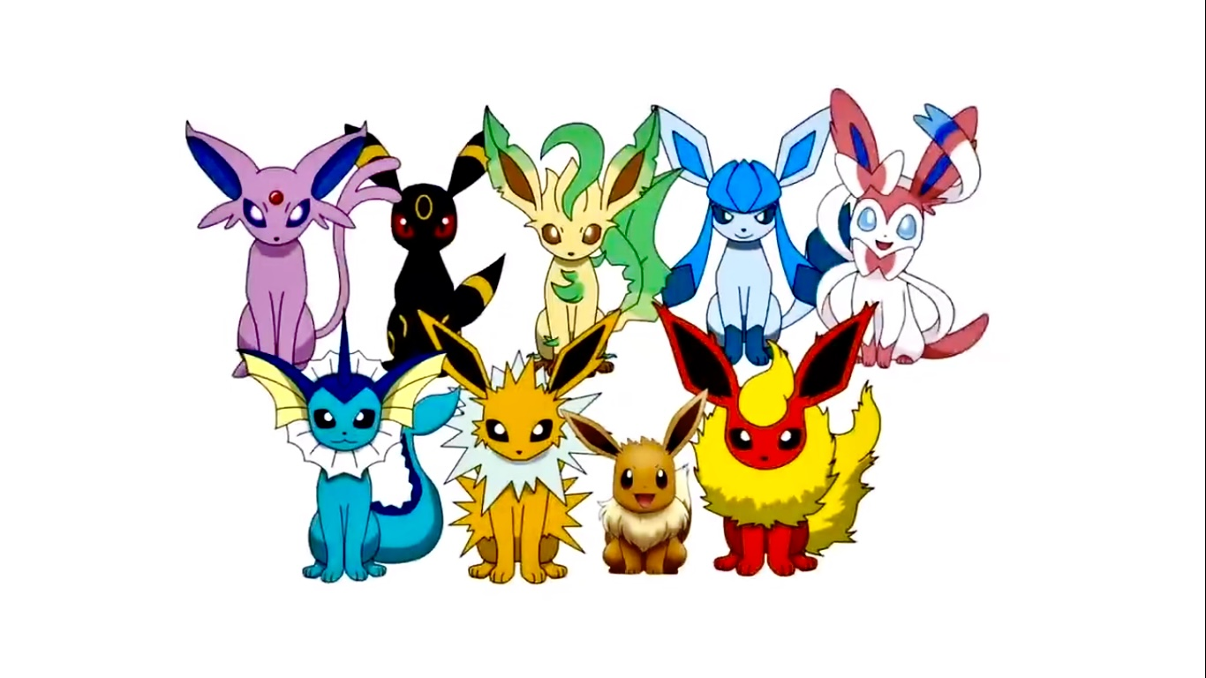
Assumption
Based on our experience and the GPU speed,
We think that the speed will be:
cv::filter2D > CUDA > OpenMP> Pthread> SIMD > Serial

Slide 22
Experiment

Slide 23

Platform
CPU：AMD Ryzen 7 5800X (8 cores 16 threads)
GPU：NVIDIA GeForce RTX 3080
OS：Window11
OpenCV：4.6.0

Slide 24
Parameter Introduce
FHD
8K
2M pixels
33M pixels
2K
5M pixels
4K
10M pixels

Slide 25
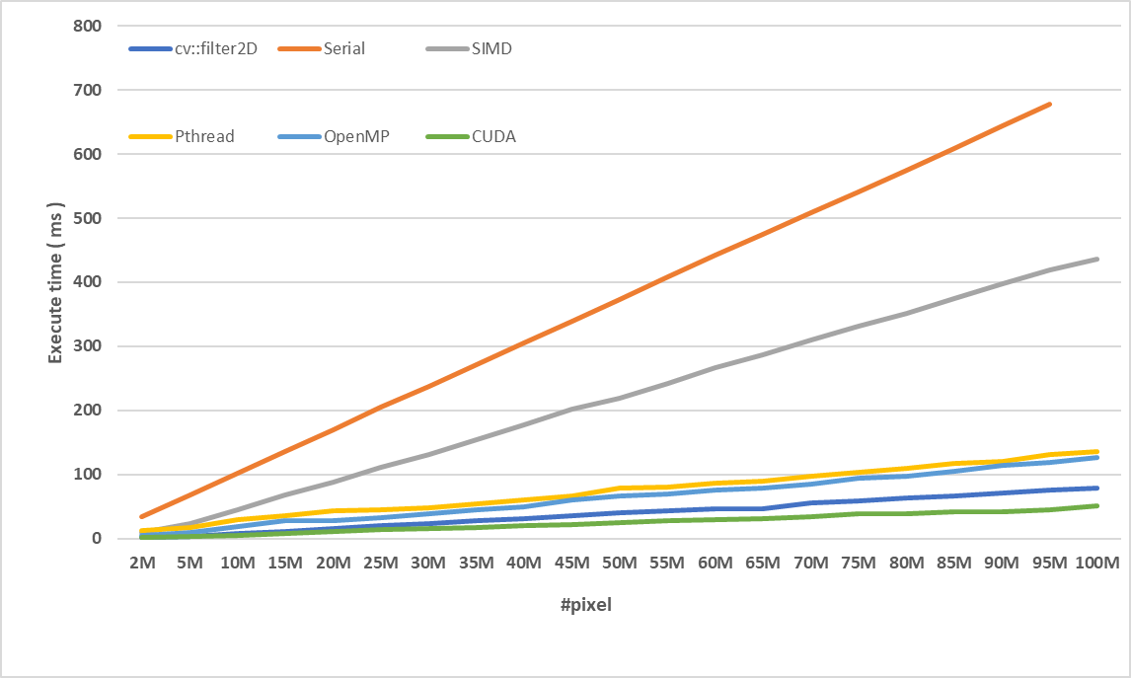
Experimental - Filter size:3x3
CUDA faster than serial
13.33x

Slide 26
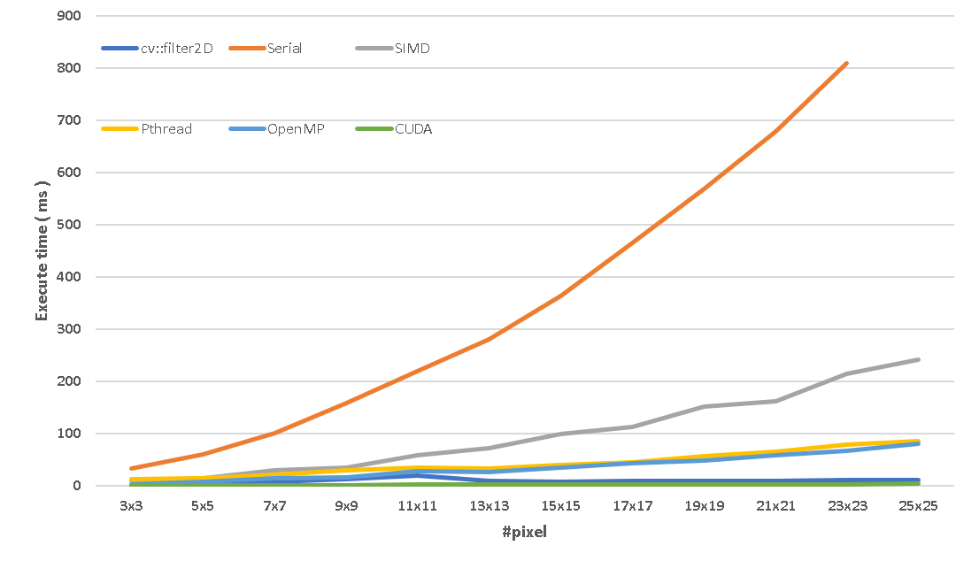
Experimental - Pixel:2M
CUDA faster than serial
255x

Slide 27
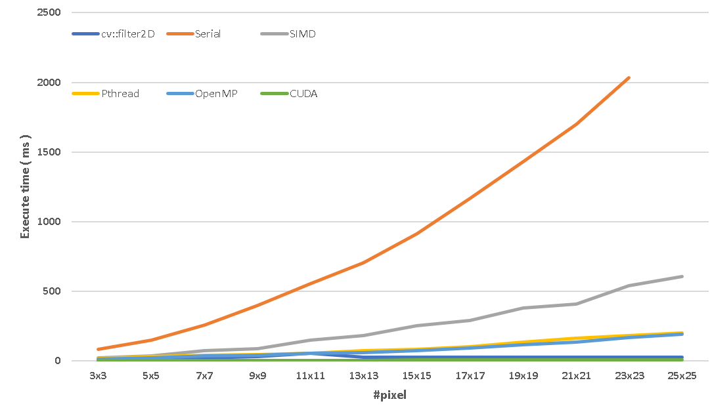
Experimental - Pixel:20M
CUDA faster than serial
294.97x

Slide 28
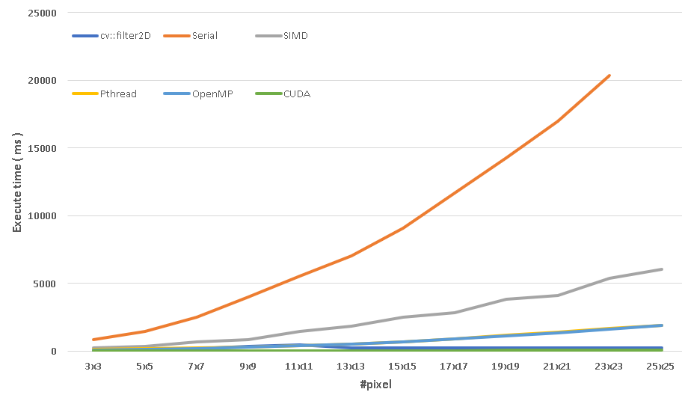
Experimental - Pixel:50M
CUDA faster than serial
349.92x

Slide 29
Experiment Result
CUDA > cv::filter2D
We think this is beacuse our cv::filter2D is based on CPU version , so GPU wins cv:filter2D
SIMD performance is bad
It is because we only use 8/per iter, while others use 16, it should do 16 too.

Slide 30
Conclusion

Slide 31
Conclusion
Using parallel methods to complete image processing can greatly improve performance, among which CUDA has the best performance than others.
Not only the number of pixels will affect the performance, but filter size also affects the performance.

Slide 32
Conclusion
Using parallel methods to complete image processing can greatly improve performance, among which CUDA has the best performance than others.
Not only the number of pixels will affect the performance, but filter size also affects the performance.

Slide 33

Thanks for listening !!

Slide 34

Q & A
Q & A

Slide 35
Appendix-3x3
Image Size | cv::filter2D | Serial | SIMD | Pthread | OpenMP | CUDA
2M | 1.6 | 14.04 | 9 | 12.7 | 4.3 | 1.5
5M | 3.98 | 34.47 | 22.9 | 17.3 | 9.5 | 3.3
10M | 7.89 | 67.72 | 45.4 | 30.1 | 19.5 | 5.4
15M | 11.5 | 102.53 | 67.5 | 35.6 | 28.1 | 7.9
20M | 15.56 | 135.95 | 88.1 | 43.4 | 28.3 | 11
25M | 19.70 | 169.85 | 111.3 | 44.4 | 33.2 | 13.6
30M | 23.70 | 204.81 | 131.6 | 48 | 38.6 | 15.5
35M | 27.86 | 237.61 | 155 | 54 | 44.4 | 17.4
40M | 31.29 | 271.51 | 176.9 | 59.7 | 49.6 | 20.3
45M | 35.07 | 305.19 | 202.3 | 66.5 | 60.9 | 22.1
50M | 39.66 | 339.63 | 219.6 | 78.3 | 66.3 | 25.1
55M | 43.11 | 373.65 | 242.3 | 79.8 | 69.6 | 28.7
60M | 47.16 | 407.77 | 266.3 | 86.1 | 75.1 | 28.9
65M | 46.29 | 441.86 | 286.9 | 89.6 | 78.7 | 31.5
70M | 55.25 | 474.63 | 309.8 | 96.9 | 85.3 | 34.4
75M | 59.20 | 509.15 | 330.7 | 103.4 | 93.6 | 38.1
80M | 62.97 | 540.92 | 352 | 109.7 | 96.8 | 39.1
85M | 66.94 | 574.38 | 374.2 | 116.9 | 105.5 | 41.4
90M | 70.87 | 608.24 | 398 | 121 | 114.4 | 42.2
95M | 74.98 | 643.71 | 418.5 | 131.4 | 118.5 | 45.4
100M | 78.87 | 677.5 | 436.8 | 136 | 125.8 | 50.8

Slide 36
Appendix-5M
Kernel Size | cv::filter2D | Serial | SIMD | Pthread | OpenMP | CUDA
3x3 | 1.6 | 14.5 | 9.2 | 12.4 | 3.4 | 1.5
5x5 | 4.2 | 33 | 13.9 | 14.6 | 8.3 | 1.5
7x7 | 8.2 | 60.2 | 29.1 | 20.6 | 13.8 | 1.6
9x9 | 13 | 100.6 | 35.1 | 29.3 | 16.2 | 1.7
11x11 | 19.6 | 158.6 | 58.4 | 34.1 | 28.2 | 1.8
13x13 | 9.7 | 218.9 | 72.8 | 32.4 | 27.1 | 1.9
15x15 | 8.5 | 280 | 99.7 | 39.5 | 34 | 2.5
17x17 | 8.7 | 364.1 | 113.5 | 45.6 | 43.3 | 2.2
19x19 | 8.8 | 465 | 151.3 | 56.9 | 49.2 | 2.4
21x21 | 9 | 568.5 | 162.2 | 64.5 | 58.6 | 2.6
23x23 | 11.2 | 678.6 | 215.2 | 79 | 67 | 3
25x25 | 10.9 | 810 | 241.4 | 85.3 | 80 | 3.6

Slide 37
Appendix-20M
Kernel Size | cv::filter2D | Serial | SIMD | Pthread | OpenMP | CUDA
3x3 | 4.2 | 35.4 | 22.7 | 16.6 | 9.9 | 3.2
5x5 | 10.6 | 83.6 | 34.9 | 29.6 | 19.4 | 3.2
7x7 | 20.4 | 147.1 | 71.5 | 39.2 | 33.6 | 3.4
9x9 | 33 | 256.6 | 86.4 | 45.5 | 38.3 | 3.6
11x11 | 55.4 | 400.5 | 146.8 | 54 | 53.6 | 3.9
13x13 | 25.2 | 553.5 | 183.4 | 73.2 | 56.8 | 4.2
15x15 | 27 | 704.7 | 249.9 | 83.6 | 73.6 | 4.9
17x17 | 25.4 | 913.3 | 287.8 | 103 | 92.3 | 4.9
19x19 | 25.6 | 1168.3 | 381.2 | 132.2 | 115.6 | 5.9
21x21 | 25.4 | 1429.4 | 409.6 | 162.1 | 136.3 | 5.9
23x23 | 25.2 | 1699.1 | 538.3 | 180.8 | 165.2 | 6.4
25x25 | 25.8 | 2035.3 | 604.5 | 202 | 190.7 | 6.9

Slide 38
Appendix-50M
Kernel Size | cv::filter2D | Serial | SIMD | Pthread | OpenMP | CUDA
3x3 | 43 | 359 | 233 | 97 | 82.8 | 26.3
5x5 | 102 | 816 | 331 | 170 | 135.9 | 26.2
7x7 | 201 | 1470 | 699 | 209 | 203.6 | 27.2
9x9 | 325 | 2525 | 850 | 284 | 284.1 | 28.9
11x11 | 482 | 3963 | 1454 | 407 | 397 | 31.2
13x13 | 247 | 5525 | 1821 | 531 | 529.4 | 33.8
15x15 | 248 | 7023 | 2491 | 696 | 695 | 37.2
17x17 | 249 | 9086 | 2831 | 912 | 880 | 39.1
19x19 | 247 | 11667 | 3836 | 1192 | 1131 | 42.4
21x21 | 248 | 14259 | 4090 | 1375 | 1359.4 | 47.1
23x23 | 250 | 16997 | 5381 | 1650 | 1606.7 | 49.2
25x25 | 252 | 20359 | 6011 | 1900 | 1884.7 | 58.3

